Slide 1
Chemistry Showcase
Due January 6

Slide 2
1.) You will conduct a chemical experiment at home or find one on-line to demonstrate a reaction that you will explain
You must video this experiment or take pictures to document. If you use an on-line experiment you will link the video to your product. This is only a small part of your project.

Slide 3
2.) Create a video, Book, Poster, or other Presentation Product of your choice to explain WHAT HAPPENED IN YOUR experiment.
You must present reaction: including the reactants and the products, explain indications of a chemical reaction (was an new substance formed, was gas given off, was there a color change, was precipitate formed, etc.).

Slide 4
3.) You must include a written paper summarizingWHAT HAPPENED IN YOUR experiment.
There is no length requirement for this paper. You must present what happened including reactants and the products and explain indications of a chemical reaction (was an new substance formed, was gas given off, was there a color change, was precipitate formed, etc.).

Slide 5
4.) You must include references and/or sites that you used to create your product.
Any sites that you looked at to figure what happened must be referenced. If you looked up an experiment instead of doing it yourself please include this reference as well.

Slide 6
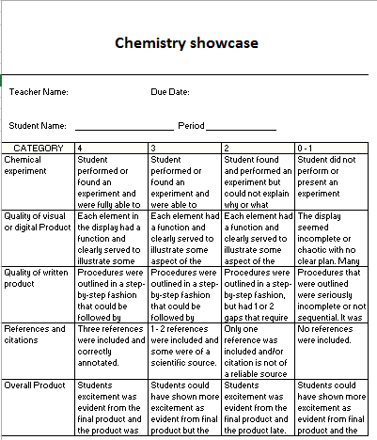
5.) You must include a rubric with a self evaluation

Slide 7
http://scifun.chem.wisc.edu/homeexpts/homeexpts.html http://chemistry.about.com/od/homeexperiments/ http://chemistry.about.com/od/chemistryactivities/ss/Top-Chemistry-Projects-You-Can-Do-at-Home.htm or many other websites for chekstry at home or in the kitchen.
Please select a chemical reaction that you can replicate at home. A good source of ideas are listed below.
Your project must contain both a visual and a written component explaining your chemical reaction. You must somewhere write out your chemical reaction including reactants and products. You must include an explanation of any of the five indications of a chemical reaction.
If we use the Conservation of Matter experiment as an example, you would write somewhere on your product -
_______1.) I have a video of me conducting the experiment or a link to a video with a voice thread explaining the video or a white board presentation of the experiment, ect.
_________2.) I have a paper written that explains my project and experiment.
_________3.) I have included a self evaluation rubric.
Indications of a chemical reaction:
Gives off a gas
Change in temperature (endothermic)

Slide 9
My experiment is ________________________________ DUE DATE ________________
The website source _______________________________
The chemical formula for this reaction is __________________________________________
Reactants are ___________________________________
Products are ____________________________________
Indications of a chemical reactant are
Temperature change _____________________________
Color Change ___________________________
New Product formed ________________________________________________
Release of Gas ______________________
Precipitate Formed _________________________
Other______________________________
Ideas I have for presenting my chemical reaction are ____________________
_____________________________________________________________________
Supplies I will need:
Help I will need from my house _____________________________________ Teacher initials
Help I will need from my teacher____________________________________ ___________

